Slide 1
Managerial Economics and
Organizational Architecture, 7E Chapter 2: Economists’ View of Behavior

Slide 2
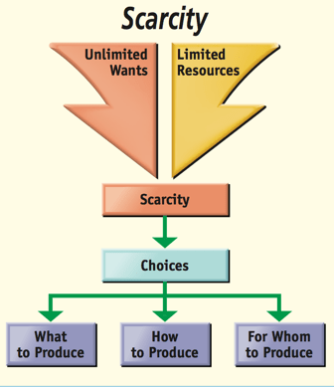
Economic Behavior
People have unlimited wants!
Resources are limited!
Choices must be made on how to allocate these scarce resources among the unlimited wants!
Kilde: https://quizlet.com/517081129/principals-of-economics-resource-utilization-diagram/
2

Slide 3
The Nature of Economic Choice
Individuals choose the preferred option, subject to constraints of:
limited resources (knowledge) and
costly and imperfect information
Individuals learn from their mistakes
3

Slide 4
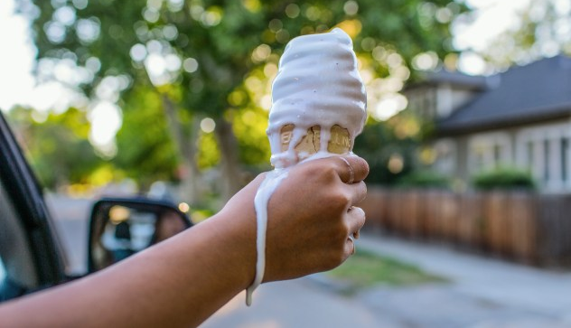
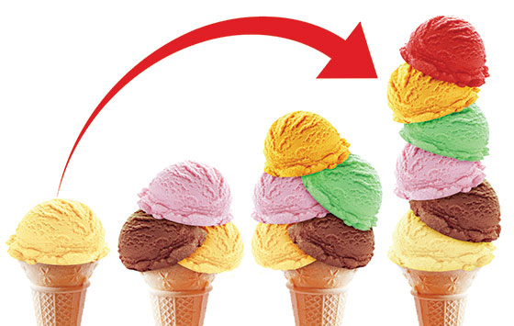
Thinking at the Margin
When choices are made, people think at the margin.
Marginal benefits are the ‘additional benefits’ obtained if the choice is made.
Marginal costs are the ‘additional costs incurred’ if the choice is made.
Take action if marginal benefits are greater than the marginal costs!!! MR>MC
Bemærk og indram note 4 (p. 14) om specielt begrebet ‘Incremental’!
Kilde: https://www.accuweather.com/en/leisure-recreation/the-truth-about-eating-ice-cream-in-the-summertime/1217266
?
+...
- …
Adaptered fra kilde: https://reformedperspective.ca/thinking-on-the-margin-or-why-some-pollution-is-better-than-none/
4

Slide 5

Sunk Costs
Benefits and costs that have preceded the decision are sunk and therefore irrelevant to the present decision – but remember; people can still learn!
“Bygones are forever bygones”/let the past rest!
If you drive three hours to the Post Malone concert in Hamburg and realize when you get to the entrance that you left your tickets at home (printer and cell phone are not accessible), what should you do?
Kilde: https://bizzi.vn/en/what-is-bird-cost/
5

Slide 6
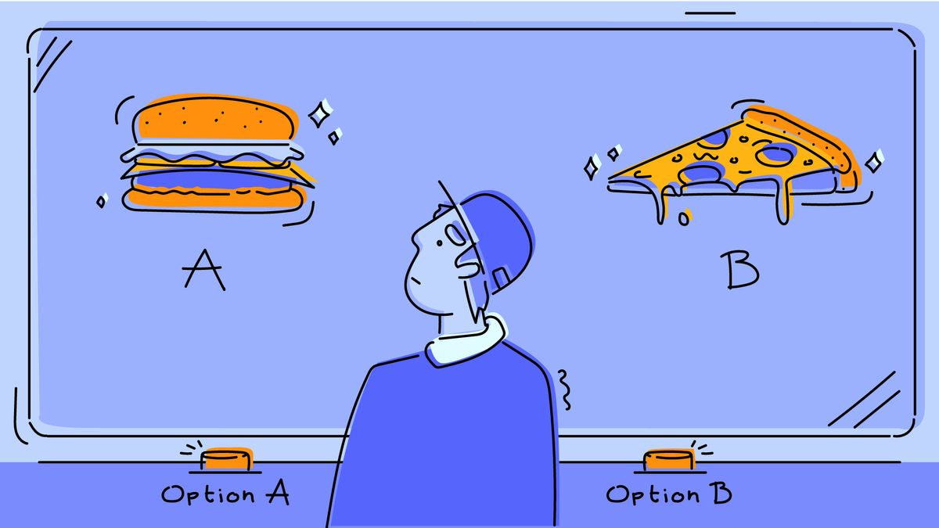
The Nature of Opportunity Costs
Choices involve trade-offs
Burger or pizza for dinner?
Go for lessons at CBS/VØS (4) or go to work/the gym, …?
Stay home or go on a nice trip?
Opportunity cost (of the selected option): The value of the foregone (forbigåede, bedste ikke valgte) option
6

Slide 7
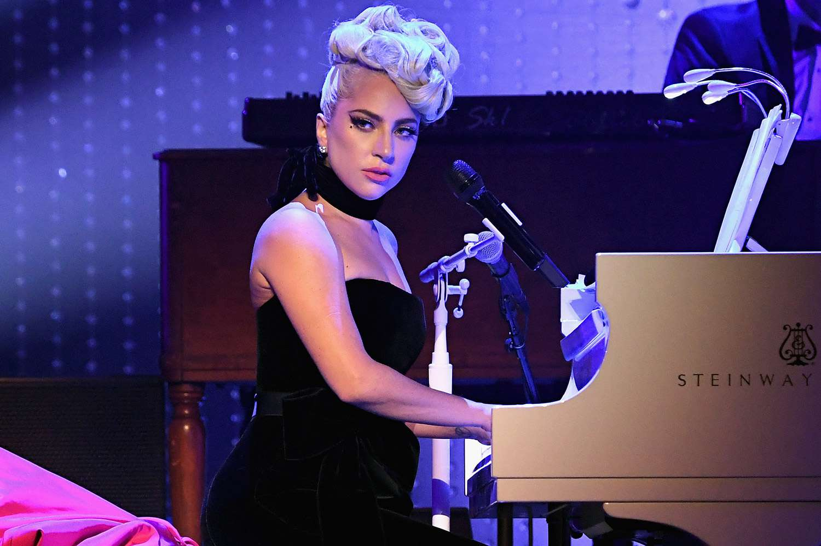
Opgave: SE-problem 2-3
Du har vundet en billet til en Lady Gaga koncert. Billetten har ingen videresalgsværdi. Bob Dylan giver koncert samme aften og er dit handlingsalternativ. Billetten til Bob Dylan koster $40. Du vil til enhver tid være villig til at give $50 for at se Bob Dylan.
Hvad er offeromkostningen ved at se Lady Gaga koncerten?​
$0​
$10​
$40​
$50
Hvor stor skal nytten være for dig ved at
ved at se Lady Gaga koncerten,
for at det er et rationelt valg at se denne?
Kilde: https://people.com/lady-gaga-announces-return-of-jazz-piano-residency-in-las-vegas-7567729
Notes:
Kapitel 2

Slide 8
The Nature of Opportunity Costs (2)
Explicit costs are direct dollar/kr/euro expenditures.
Implicit costs reflect opportunity costs that are not direct dollar expenditures
using your time to run a business
the hours not used with friends or family
search for information
slack
…..
8

Slide 9
The Use of Graphical Tools
Desired goal: Maximize utility
Utility = f(Food, Clothing),
subject to a budget constraint
This can be shown graphically with indifference curves and budget constraints
9

Slide 10
Indifference Curves
For a utility function U = f(Food, Clothing)
Indifference curves show all combinations of food and clothing that yield the same level of utility
Indifference curves have negative slopes – this indicates a tradeoff between food and clothing
10

Slide 11
Indifference Curves Diagram
F
25
16
Quantity of Food
U=20
4
U=8
C
4
16
25
11
Quantity of Clothing

Slide 12

The Budget Constraint
I (ncome) ≥ P_{f}F + P_{c}C
which can be rearranged as
F ≤ I/P_{f} - (P_{c}/P_{f})C
and this can be drawn as …
Kilde: https://unsplash.com/s/photos/empty-wallet
12

Slide 13
The Budget Constraint Diagram
F
Combinations above the line
are unaffordable
Quantity of Food
Combinations below the line
are affordable
C
Quantity of Clothing
13

Slide 14
The Budget Constraint Diagram
F
Higher Income
Original Constraint
Quantity of Food
Lower Income
C
14
Quantity of Clothing

Slide 15
Changing a Price
F
In this example, changes in the price of clothing change the slope of the budget constraint. Higher prices (cloth) produce a steeper line, and lower prices produce a flatter line.
Increase in the price of clothing
Quantity of Food
Original Constraint
Decrease in the price of
clothing
C
Quantity of Clothing
15

Slide 16
Combining Indifference Curves and the Budget Constraint
F
This individual is best off by choosing point a (F*, C*), where the constraint is tangent to curve 2.
Points on curve 3 are preferred but infeasible.
Quantity of Food
3
F*
a
2
1
C
C*
16
Quantity of Clothing

Slide 17
Changing the Price of Food
F
An increase in the price of food changes the optimal choice. In this example, the amount of food purchased declines, while clothing purchases remain unchanged.
Original Constraint
Constraint after increase in the price of food
Quantity of Food
F*₀
F*₁
C
C*
Quantity of Clothing
17

Slide 18


Using Budgets to Motivate Workers
Wells Fargo paid its analysts bonuses based on the analyst’s contribution to the banking side of their business.
If an analyst rated a company as a poor investment, that company (could and sometimes did) take its business elsewhere =>
The analyst’s bonus would be smaller!
The analyst’s tradeoff (‘til gengæld for’, ‘omk. ved’, ‘afvejning mellem’) is integrity for money!
Kilde: https://www.investopedia.com/terms/c/cash-bonus.asp
Kilde: https://sacsconsulting.com/2017/09/21/detect-lies-workplace/
18

Slide 19
Hypothetical Constraint at Wells Fargo
$
This constraint shows the maximum amounts of money and integrity that are possible for the analyst, given the bonus/compensation plan and conditions at Wells Fargo.
$_{max}
Income (in dollars)
$_{min}
I
I_{c}
Quantity of integrity
19

Slide 20
Optimal Analyst Choice Two Different Compensation Plans
$
Case 1 reflects the original compensation plan, while the compensation in Case 2 encourages the analyst to choose a higher level of integrity.
Managers can motivate desired actions by establishing appropriate incentives, jvf. kap. 1!
Income (in dollars)
$*₁
$*₂
Case 2
Case 1
I
I*₁
I*₂
Quantity of integrity
20

Slide 21
Alternative Models of Behavior
Happy-is-productive
promote employee satisfaction
Good citizen
communicate, facilitate, and praise
Product of the environment
hire the right people
Economic model/man is used throughout this book:
change relevant costs and benefits (MR > MC)
incentives matter
21

Slide 22
Decision Making Under Uncertainty
Since nothing is guaranteed, we make decisions based on the expected value of the outcome:
The amount of risk is measured by the standard deviation of the value of the outcomes:
People choose a balance between expected value (return) and risk
Hvor
1) P = %
2) V = value
3) Standard-afvigelsen er kvadratroden af variansen
22

Slide 23
Risk Versus Return
$
Increasing utility
This risk-averse individual prefers higher expected value but lower standard deviation (a measure of risk).
3
Expected value (in dollars)
2
100,000
1
Risk premium = $20,000
80,000
NB: P. 38 m. – n.!
The certainty equivalent = $80,000
$
81,650
Standard deviation (in dollars)
23

Slide 24
Appendix Material

Slide 25
Slope of Tom’s (Hank) Indifference Curve in the movie ‘Cast Away’
Indifference curve for 100 units of utility
Faldende marginalnytte!
20
A (5, 20): MRS = 4
Quantity of Burgers
10
B (10, 10): MRS = 1
C (20, 5): MRS = .25
5
5
10
20
Quantity of shirts
This indifference curve reflects 100 units of utility. The equation for the curve is F=100/c, and the slope at any point is – (MU_{C}/MU_{F}). The absolute value of the slope is the marginal rate of substitution (MRS), which declines continuously along the curve.
25

Slide 26
Income and Substitution Effects
F
Fra t1 -> t2:
Qcloth fra 25 til 12,5 skyldes dels, at tøj er blevet dyrere ift. mad, dels at I er blevet mindre fordi….. tøj er blevet dyrere!
With budget line B₁ and indifference curve I₁, Tom chooses t₁.
When clothing becomes more expensive, Tom moves to t₂.
This includes a substitution effect (t₁⇨t’) and an income effect (t’⇨t₂).
Quantity of Food
t’
70.6
50
t₁
t₂
B₁
B₂
B’
C
12.5
25
17.7
Quantity of Clothing
26

Slide 27
Income Effects in Labor Supply
100
Budget line for wage = $10/hr.
Offeromkostningen stiger ved at holde fri, hvis W stiger, og alligevel vælger Ralph at arbejde mindre?
60
Leisure time (hr)
Budget line for wage = $20/hr.
40
$600
$1,000
$2,000
Total income
Ralph Kramden divides 100 hours per week between work and leisure. When his wage rate rises, he works fewer hours because ……..?
27

